Slide 1
Basics
Web Application Architecture.
Web Browser(Front End)
Web Server (Backend)
What happens when you type an address in browser?

Slide 2
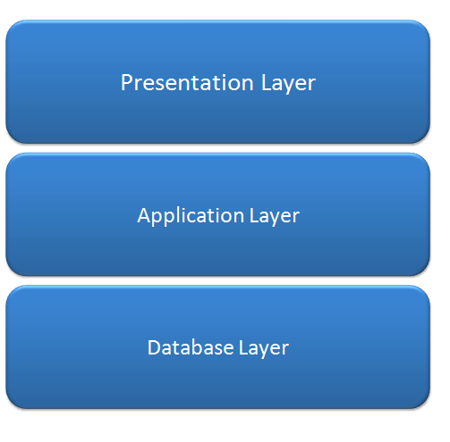
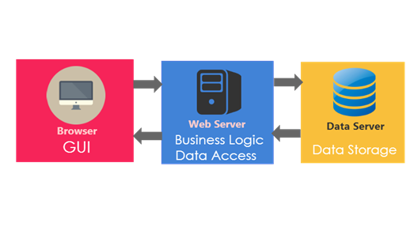

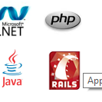
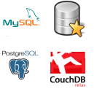
Web Application Architecture

Slide 3
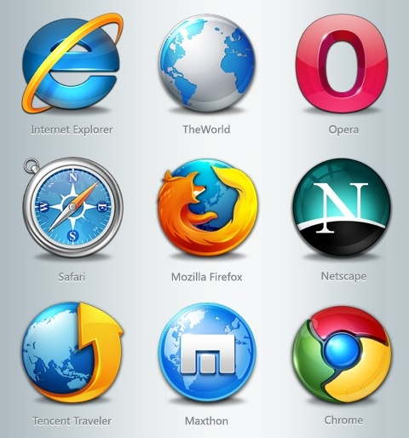
Web Browser
The primary purpose is to bring information resources to the user.
An application for retrieving, presenting, and traversing information resources.
Technology consists of Combination of Html,CSS,Javascript.
Browser has Rendering Engine, JavaScript interpreter.

Slide 4


Web Server
The term web server can mean one of two things:
A computer program that accepts HTTP requests and return HTTP responses with optional data content.
A computer that runs a computer program as described above.
A web server is a piece of software that enables a website to be viewed using HTTP.

Slide 5
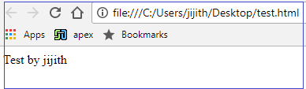
Viewing HTML Files Without a Web Server
Example : file:///C:/Users/jijith/Desktop/test.html
These example are using the file protocol in order to display the files.
Now, this isn't normally a problem if you're only using client side languages such as HTML, CSS, and client-side JavaScript. But it is a problem if you're trying to use a server-side language such as PHP, ColdFusion etc.
Viewing HTML Files With a Web Server
When you view a web page via a web server, the URL begins with http://.
The URL will consist of either an IP address or a domain name/host name.

Slide 6
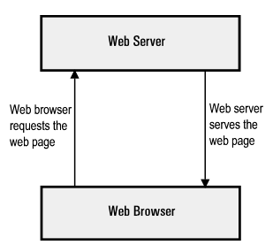
How Web Servers Work
Browser Resolves the Domain Name to an IP Address
Note that the IP address was assigned when the website was first created on the web server.
Browser Requests the Full URL
Web Server sends the Requested Page
Browser Displays the Webpage

Slide 7
URL
URL-Uniform Resource Locator
Address of a specific webpage or file on the Internet
A URL has two main components:
Protocol identifier: For the URL http://example.com, the protocol identifier is http.
Resource name: For the URL http://example.com, the resource name is example.com.
Eg: Flipkart
https://www.flipkart.com/mobiles?otracker=nmenu_sub_Electronics_0_Mobiles
https:// – the URL prefix, which specifies the protocol used to access the location
www.flipkart.com – the server name or IP address of the server
/mobiles?otracker=nmenu_sub_Electronics_0_Mobiles – the path to the directory or file

Slide 8
MVC Introduction
The ASP.NET MVC is a web application framework developed by Microsoft, which implements the model-view-controller(MVC) pattern. It is open-source software, apart from the ASP.NET Web Forms component which is proprietary.
ASP.NET MVC was designed for creating websites.
Development Environment
Visual Studio
Visual Studio is an IDE, or integrated development environment.
Just like you use Microsoft Word to write documents, you'll use an IDE to create applications

Slide 9
Why MVC
The main advantages of ASP.net MVC are:
Enables the full control over the rendered HTML.
Provides clean separation of concerns(SoC).
Enables Test Driven Development(TDD).
Easy integration with JavaScript frameworks.
Following the design of stateless nature of the web.
RESTful urls that enables SEO.
No ViewState and PostBack events

Slide 10
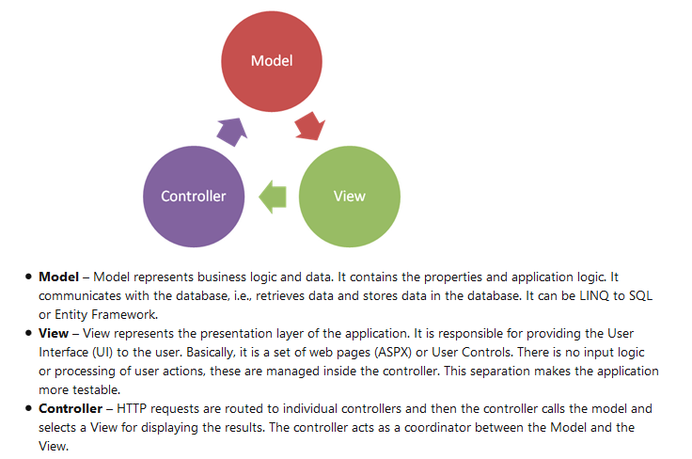
MVC Architecture
It is a loosely coupled development framework as it is divided into three layers.

Slide 11
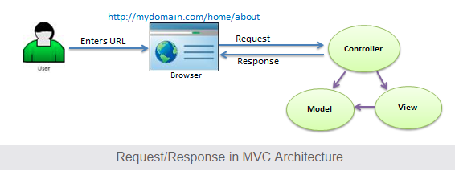
Request Flow in MVC
When the user enters a URL in the browser, it goes to the server and calls appropriate controller. Then, the Controller uses the appropriate View and Model and creates the response and sends it back to the user. We will see the details of the interaction in the next few sections.

Slide 12
ASP.NET MVC Version History
MVC Version | Visual Studio | .Net Version | Release date | Features
MVC 1.0 | VS2008 | .Net 3.5 | 13-Mar-2009 | MVC architecture with webform engine Routing HTML Helpers Ajax Helpers Auto binding
MVC 2.0 | VS 2008 | .Net 3.5/4.0 | 10-Mar-2010 | Area Asynchronous controller Html helper methods with lambda expression DataAnnotations attributes Client side validation Custom template Scaffolding
MVC 3.0 | VS 2010 | .Net 4.0 | 13-Jan-2011 | Unobtrusive javascript validation Razor view engine Global filters Remote validation Dependency resolver for IoC ViewBag

Slide 13
MVC 4.0 | VS 2010 SP1, VS 2012 | .NET 4.0/4.5 | 15-Aug-2012 | Mobile project template Bundling and minification Support for Windows Azure SDK
MVC 5.0 | VS 2013 | .NET 4.5 | 17-oct-2013 | Authentication filters Bootstrap support New scaffolding items ASP.Net Identity
MVC 5.2 - Current | VS 2013 | .NET 4.5 | 28-Aug-2014 | Attribute based routing bug fixes and minor features upate

Slide 14
Points to Remember :
MVC stands for Model, View and Controller.
Model is responsible for maintaining application data and business logic.
View is a user interface of the application, which displays the data.
Controller handles user's requests and renders appropriate View with Model data.

Slide 15
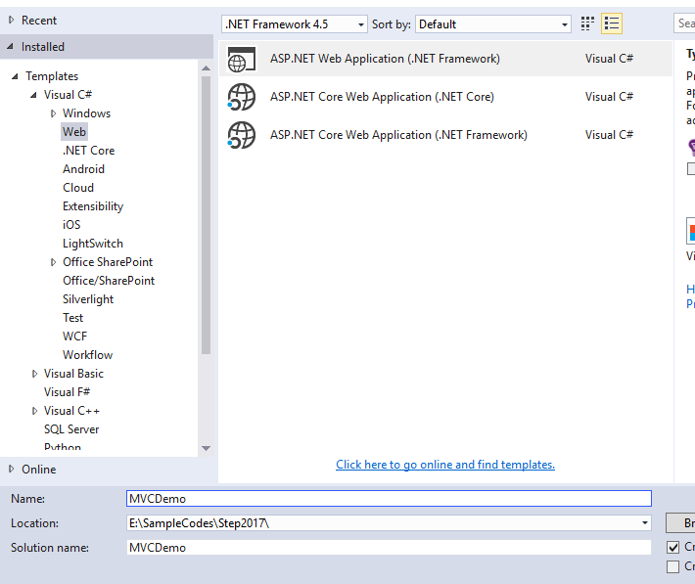
Create first simple MVC application

Slide 16
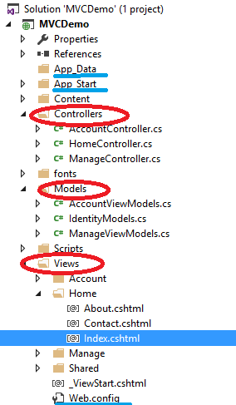
ASP.NET MVC Folder Structure
App_Data: Application data files like LocalDB, .mdf files, xml files and other data related files. IIS will never serve files from App_Data folder.
App_Start: files which will be executed when the application starts.
Controllers: Controllers folder contains class files for the controllers. Controllers handles users' request and returns a response. MVC requires the name of all controller files to end with Controller
Models: Models folder contains model class files for manipulating application data
Views: Html files for application
Separate folder for each controllers. Eg:Home folder for Home Controller .
Shared folder shares files across all controllers. Eg:layout files

Slide 17
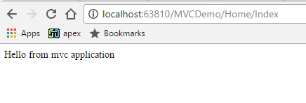
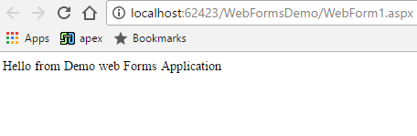
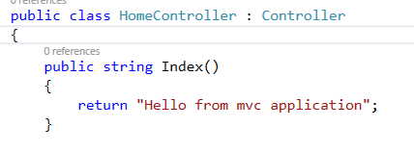
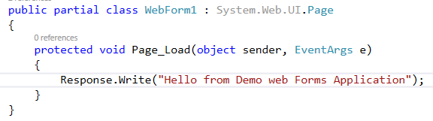
Creating your asp.net mvc application
http://localhost/MVCDemo/Home/index
↓ ↓ ↓
Server Project Controller
http://localhost:62423/WebFormsDemo/WebForm1.aspx
In the URL "Home" is the name of the controller and "Index" is the method within HomeController class.
Where as in web forms application, the URL is mapped to a physical file

Slide 18
Controllers in MVC application
Handles incoming URL request.
Base class System.Web.Mvc.Controller.
Controller class contains public methods called Action methods.
Every controller class name must end with a word Controller. Eg:Controller for student must be StudentController.
Every controller class must be located in Controller folder of MVC folder structure.

Slide 19
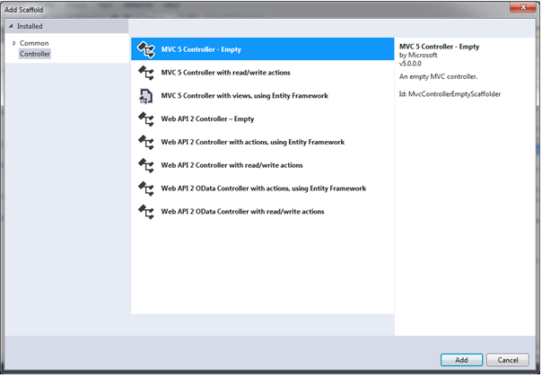
Adding a new Controller
Scaffolding: Automatic code generation framework

Slide 20
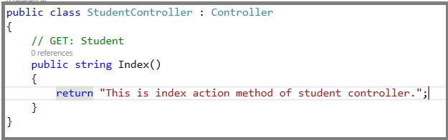
Student Controller derives from controller class.
Base Controller class contains helper methods that can be used for various purposes.
http://localhost/MVCDemo/Home/index invokes Home Controller and index action methods.
http://localhost:63810/MVCDemo/Student/Index invokes Student Controller and index action methods.
How and Where that mapping is defined and stored?

Slide 21
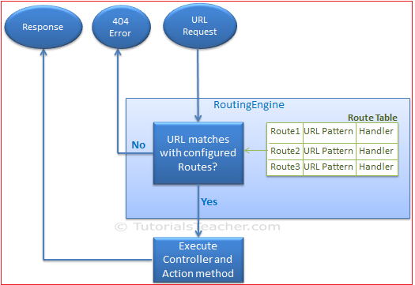
Routing
Routing module is responsible for mapping incoming browser requests to particular MVC controller actions
Routing is a pattern matching system that monitor the incoming request and figure out what to do with that request.
At runtime, Routing engine use the Route table for matching the incoming request's URL pattern against the URL patterns defined in the Route table.

Slide 22
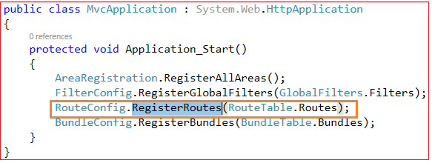
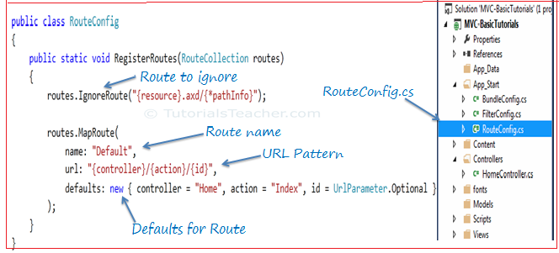

Configure Route
Mapping defined in Global.asax
Register route Method.
http://localhost/MVCDemo/Home/Index
Id is optional
http://localhost:63810/MVCDemo/Home/Index/10

Slide 23
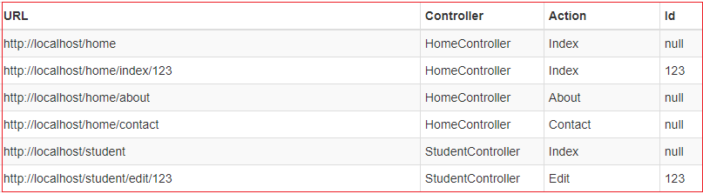
URL Pattern
Considered only after domain name part in the URL
Eg: http://localhost:63810/MVCDemo/Home/Index
http://localhost:63810/MVCDemo/ invokes default parameters

Slide 24
Task
Action Method
Action Verbs
Action Selectors
Create an MVC application with student controller. create an action method that returns multiple students.

Slide 25
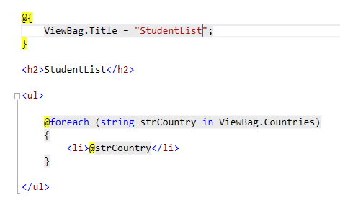
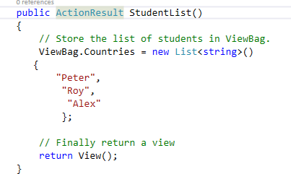
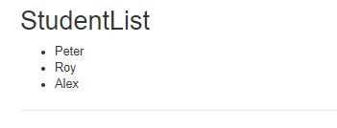
View
Controller Action
Result

Slide 26
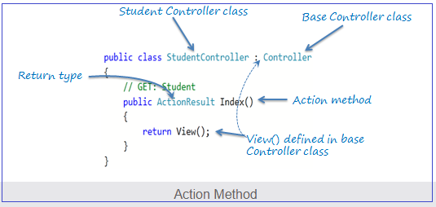
Action method
Action method must be public. It cannot be private or protected
Action method cannot be overloaded
Action method cannot be a static method.

Slide 27
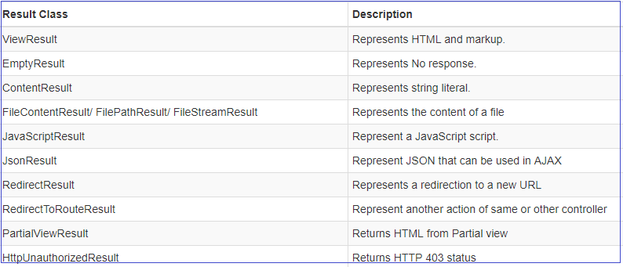
ActionResult
The ActionResult class is a base class of all the above result classes, so it can be return type of action methods which returns any type of result listed above. However, you can specify appropriate result class as a return type of action method.

Slide 28
Points to Remember :
All the public methods in the Controller class are called Action methods.
Action method has following restrictions. - Action method must be public. It cannot be private or protected. - Action method cannot be overloaded. - Action method cannot be a static method.
ActionResult is a base class of all the result type which returns from Action method.
Base Controller class contains methods that returns appropriate result type e.g. View(), Content(), File(), JavaScript() etc.

Slide 29
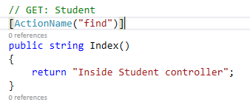
Action Selectors
Action selector is the attribute that can be applied to the action methods
ActionName
ActionName attribute allows us to specify a different action name than the method name.
New URL- http://localhost/student/find

Slide 30
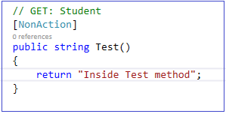
2. NonAction
Non Action selector attribute indicates that a public method of a Controller is not an action method. Use NonAction attribute when you want public method in a controller but do not want to treat it as an action method

Slide 31
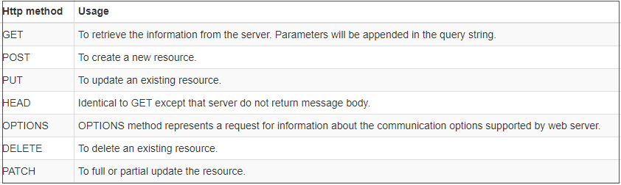
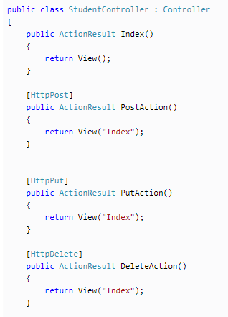
3. ActionVerbs

Slide 32
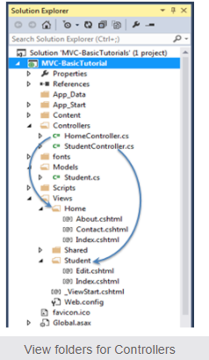
Views in an mvc application
View is a user interface. View displays data from the model to the user and also enables them to modify the data.
ASP.NET MVC views are stored in Views folder.
Views, which will be rendered from any of the action methods of HomeController, resides in Views > Home folder.

Slide 33
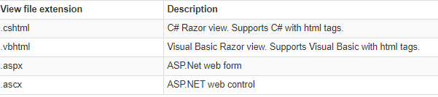
View engines in asp.net mvc
Out of the box asp.net offers the following 2 view engines. 1. ASPX 2. Razor
Microsoft introduced the Razor view engine and packaged with MVC 3.
You can write a mix of html tags and server side code in razor view.
Razor uses @ character for server side code instead of traditional <% %>.
You can use C# or Visual Basic syntax to write server side code inside razor view.
Razor view engine maximize the speed of writing code by minimizing the number of characters and keystrokes required when writing a view.
Razor views files have .cshtml or vbhtml extension.

Slide 34
1. What is the difference between RAZOR and ASPX view engines?
ASPX view engine, the server side script is wrapped between <% %>, where as in RAZOR we use @
2. Is it possible, to have both RAZOR and ASPX views in one application?
Yes
3. Is it possible, to use a third party view engine with asp.net mvc?
ASP.NET MVC is designed with extensibility in mind. So, it's very easy to include third party view engine as well.

Slide 35
Models in MVC application
To Encapsulate data or information
Model represents domain specific data and business logic in MVC architecture.
It maintains the data of the application.
Model class holds data in public properties.

